Slide 1
Overall idea
IRC: use the Markovian property to solve the POMDP in the reverse order for likelihood. Then maximize the likelihood wrt theta.
Need to solve n times for 1 trajectory data, n as samples, pretty slow.
Need a decent data size. Very hard to search for a theta given few trajectories, since the inverse model did not learn to generalize.
Thus, we need to have a large data set before inverse. Cannot do active learning.

Slide 2
Overall idea
Active IRC.
Use a network to learn the solution of reverse POMDPs and generalize over different samples.
Instant inverse, inverse is just network inference. Able to use very few data to update theta iteratively, by variational inference for example.
Allow active learning. Active learning requires 1. have a theta prior (near online inverse) and 2. calculation of information. This approach potentially allows active learning. The inverse model can have targeted exploration of subject’s internal model, instead of random exploration.

Slide 3
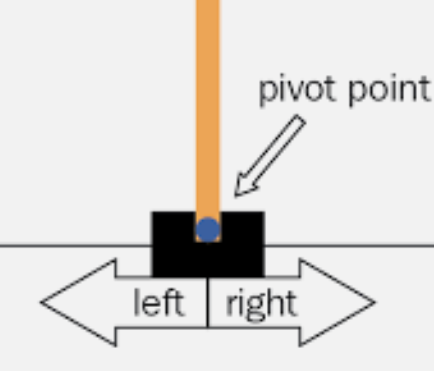
Cartpole as an example task
4 observation
3 action (left, right, no action)
Phi: pole length
Theta: pole length

Slide 4
Work flow
Task configuration, phi
Agent assumption, theta
Trajectories, T_sim
1, collect all trajectories T_sim by MDP, T(phi, theta)
2, train a backward function F, such that F(T_phi,theta) -> phi, theta
3, use the backward function F to inference as inverse, F(T_actual)->theta
4, use the T_sim, F, and current theta_hat to actively choose best phi

Slide 5
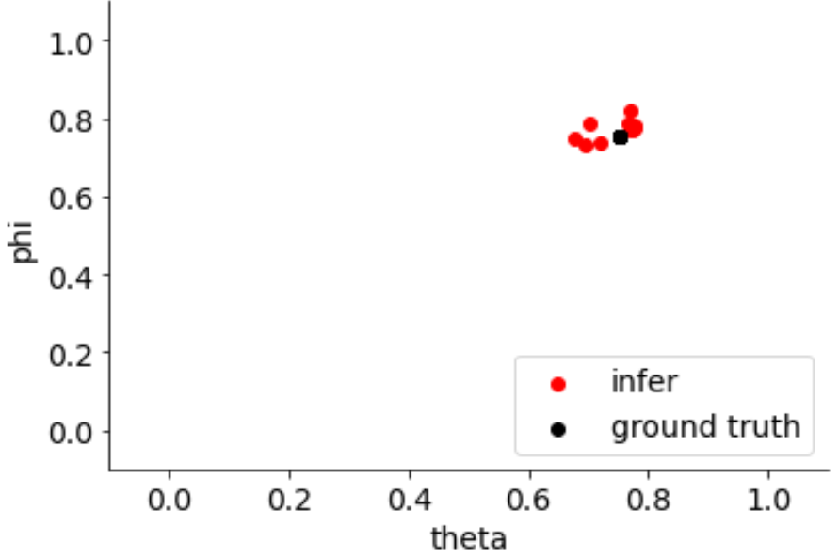
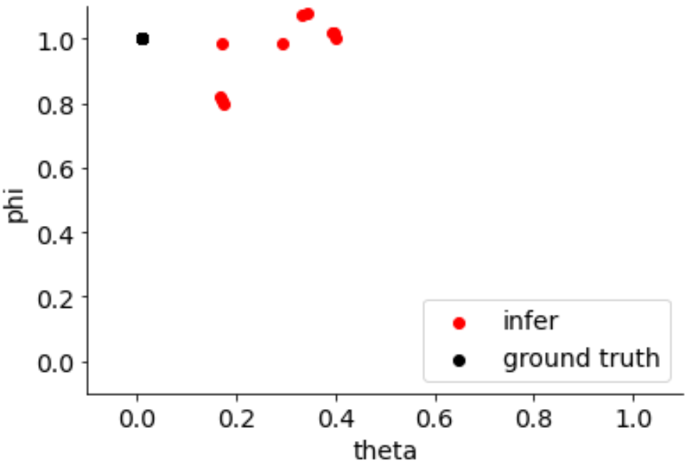
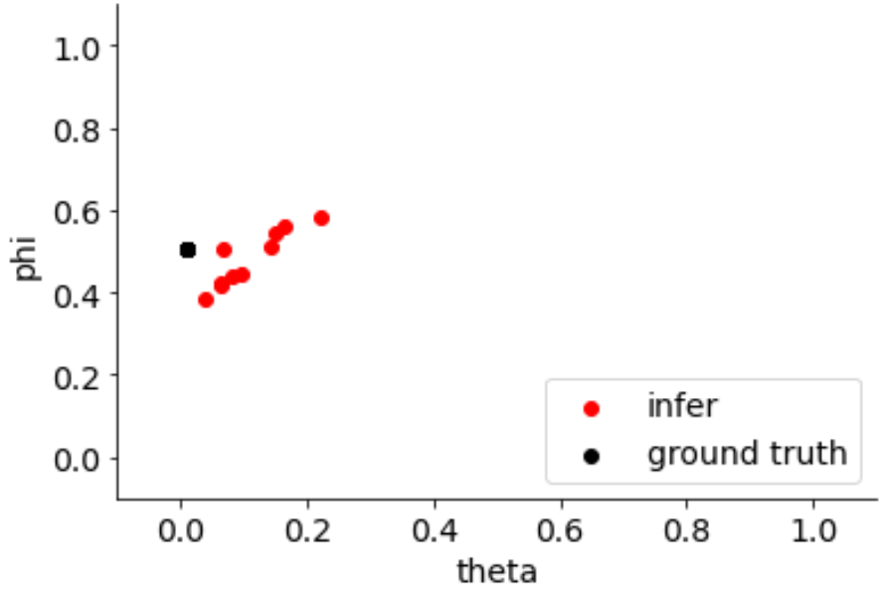
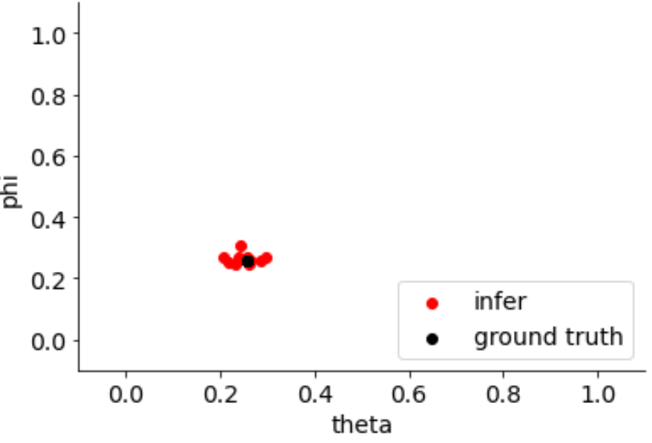
example
Resolution=5,
1000 trial per condition
25 conditions
Mseloss,
Output deterministic

Slide 6
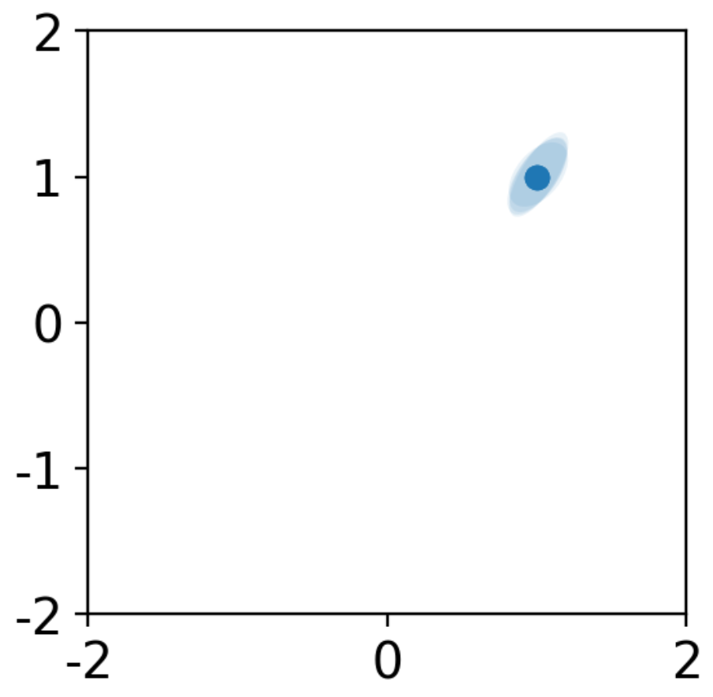
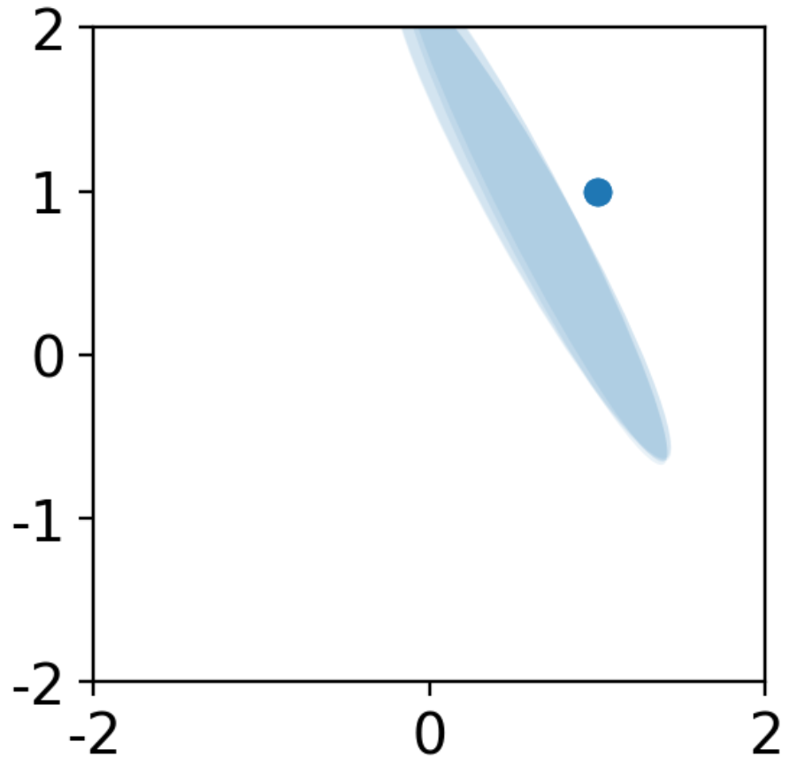
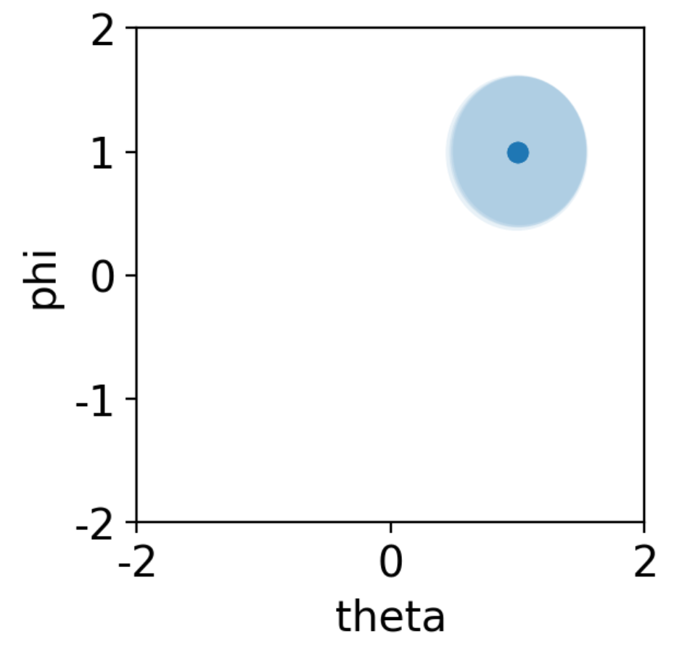
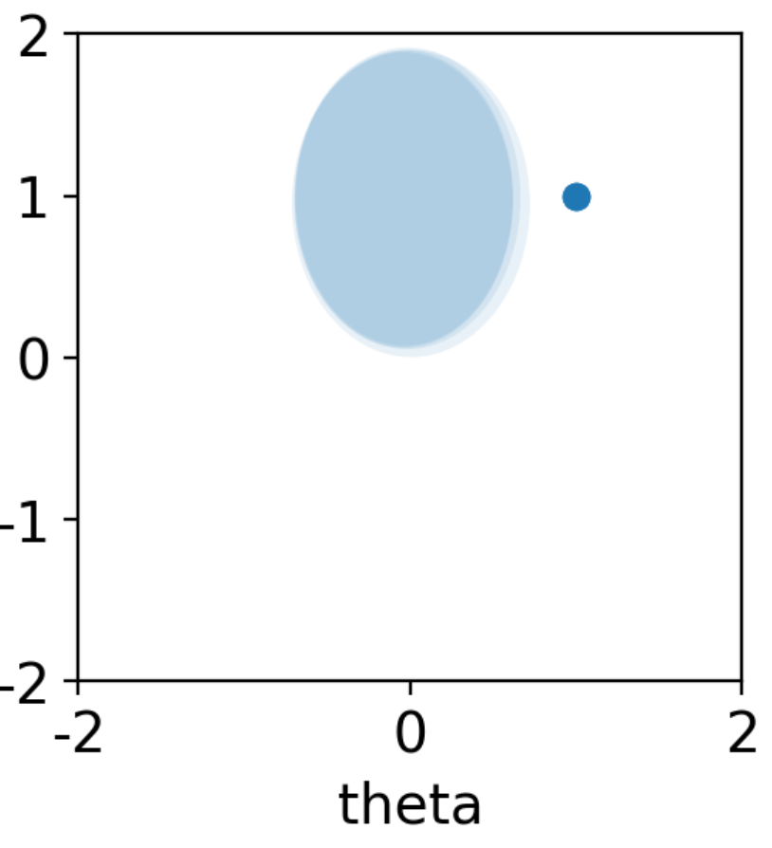
example
Use covariance
if early stop or use the best model
Same data
Output probability
-log likelihood and mse
Very unstable!
Not stable!
Use variance only
if only use variance not covariance, still not stablef.

Slide 7

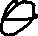
Active learning
Starts from a theta prior. P(theta)
We want to know, what task (phi) provide maximum information about theta.
Eg, we want a task phi_i, such that the trajectory of T(phi_i, peak theta) differs from T(phi_i, other theta).
This can be formulated as:
For each phi_i,
{use the (phi_i) as key to get a row of trajectory T_phi.
weight the trajectory change with p(theta): abs(diff(T_phi) dot p(theta)}
take the argmax phi as the most informative task.
The abs(diff(T_phi) can be pre calculated. The complexity is n dot operations, where n is the number of tasks to choose from.

Slide 8
Active learning example
F output probability.
subF output vector trajectory embedding.
Start from a theta prior
for all phi, calculate sum(p(theta) . subF(phi)).
find the max phi, this is our best task.

Slide 9
Next step
For active learning, we need a slightly hard task?
now, we can do near one shot learning
also, no task config is significantly better than others.
decrease trial len?
For probability output.

Slide 10

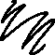





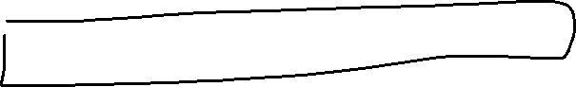


Slide 11

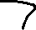

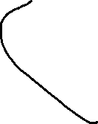
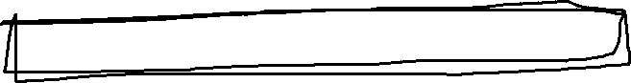
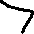
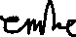

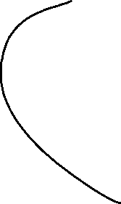
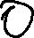

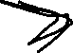
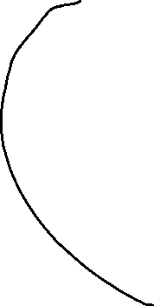

Slide 12


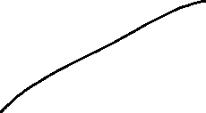
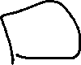
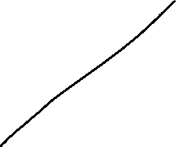
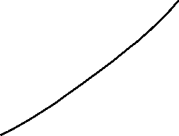
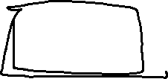
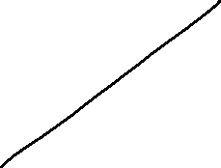
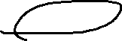
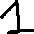
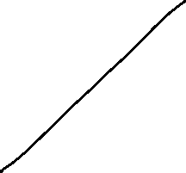


Slide 13

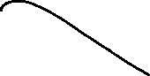
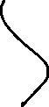
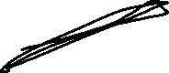
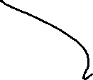
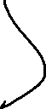
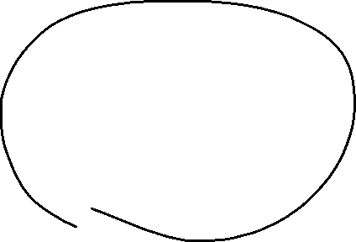

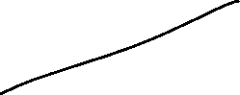





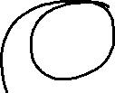
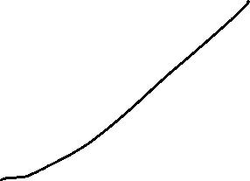


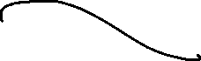

Slide 14
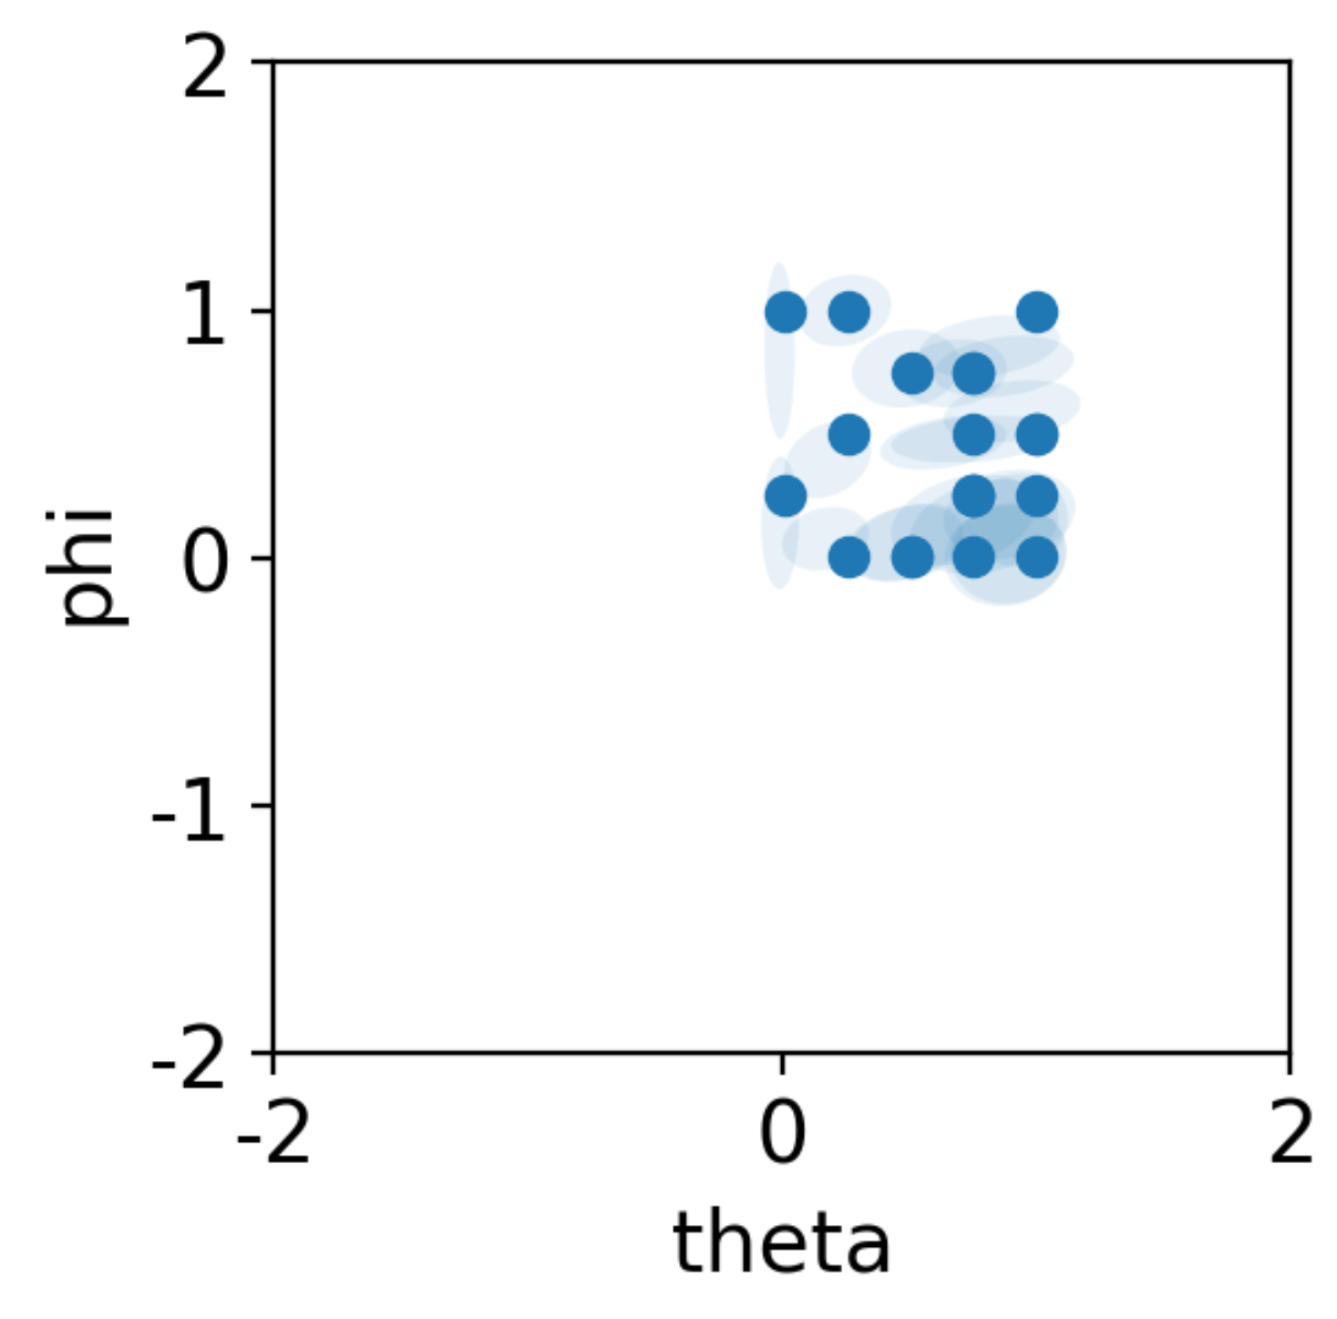
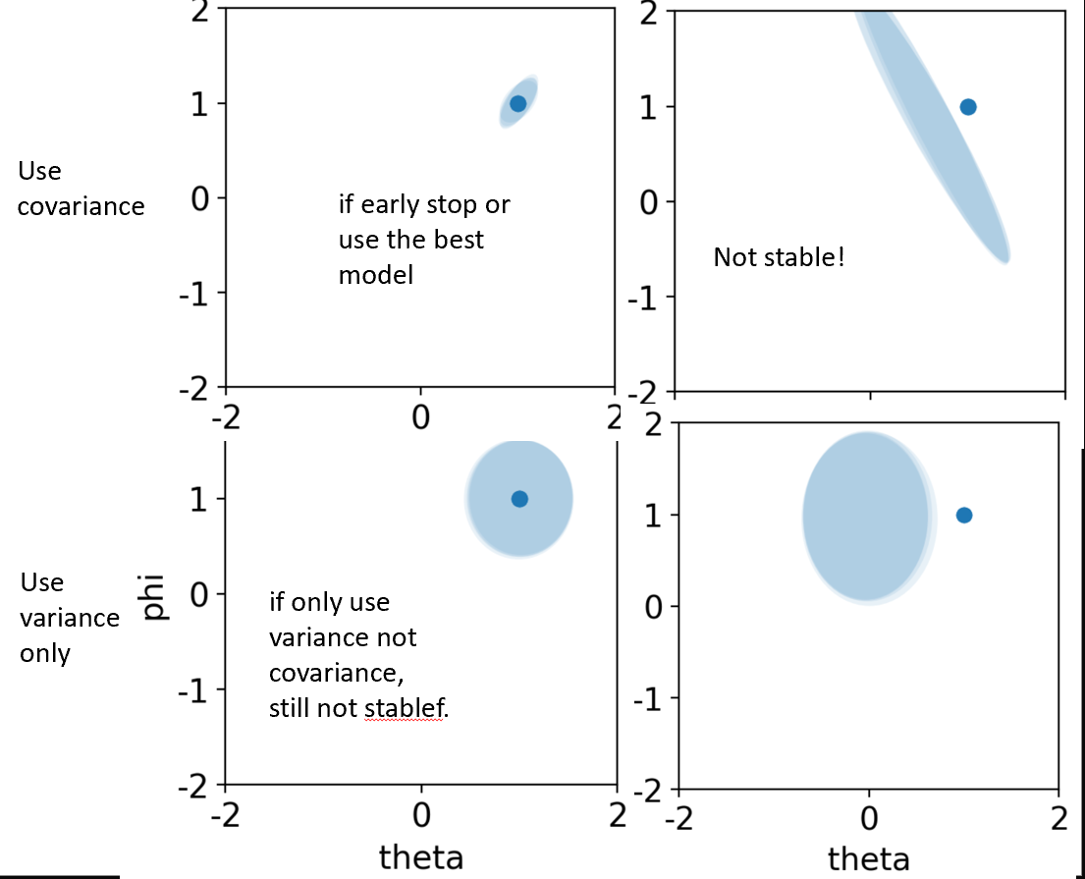
Mean+cov ouput, continuous case
Figured out a grad clipping that make the network stable
Left: previous, right, updated

Slide 15
0428, cont on part 2
Implement the Bayesian adaptive task selection procedure
Compare the proven optimal procedure vs our part 2

Slide 16
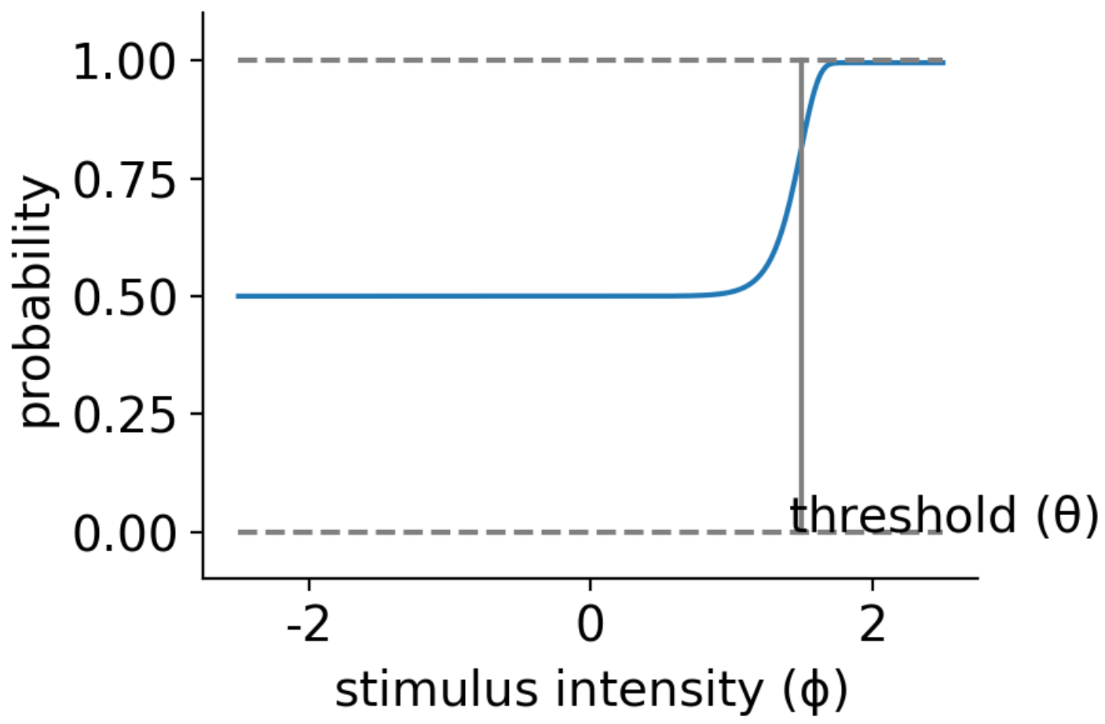



Example psychometric function $ψ$
param to infer(theta):
Threshold
Other fixed params:
Slope
Guess rate (false alarm)
Lapse rate

Slide 17
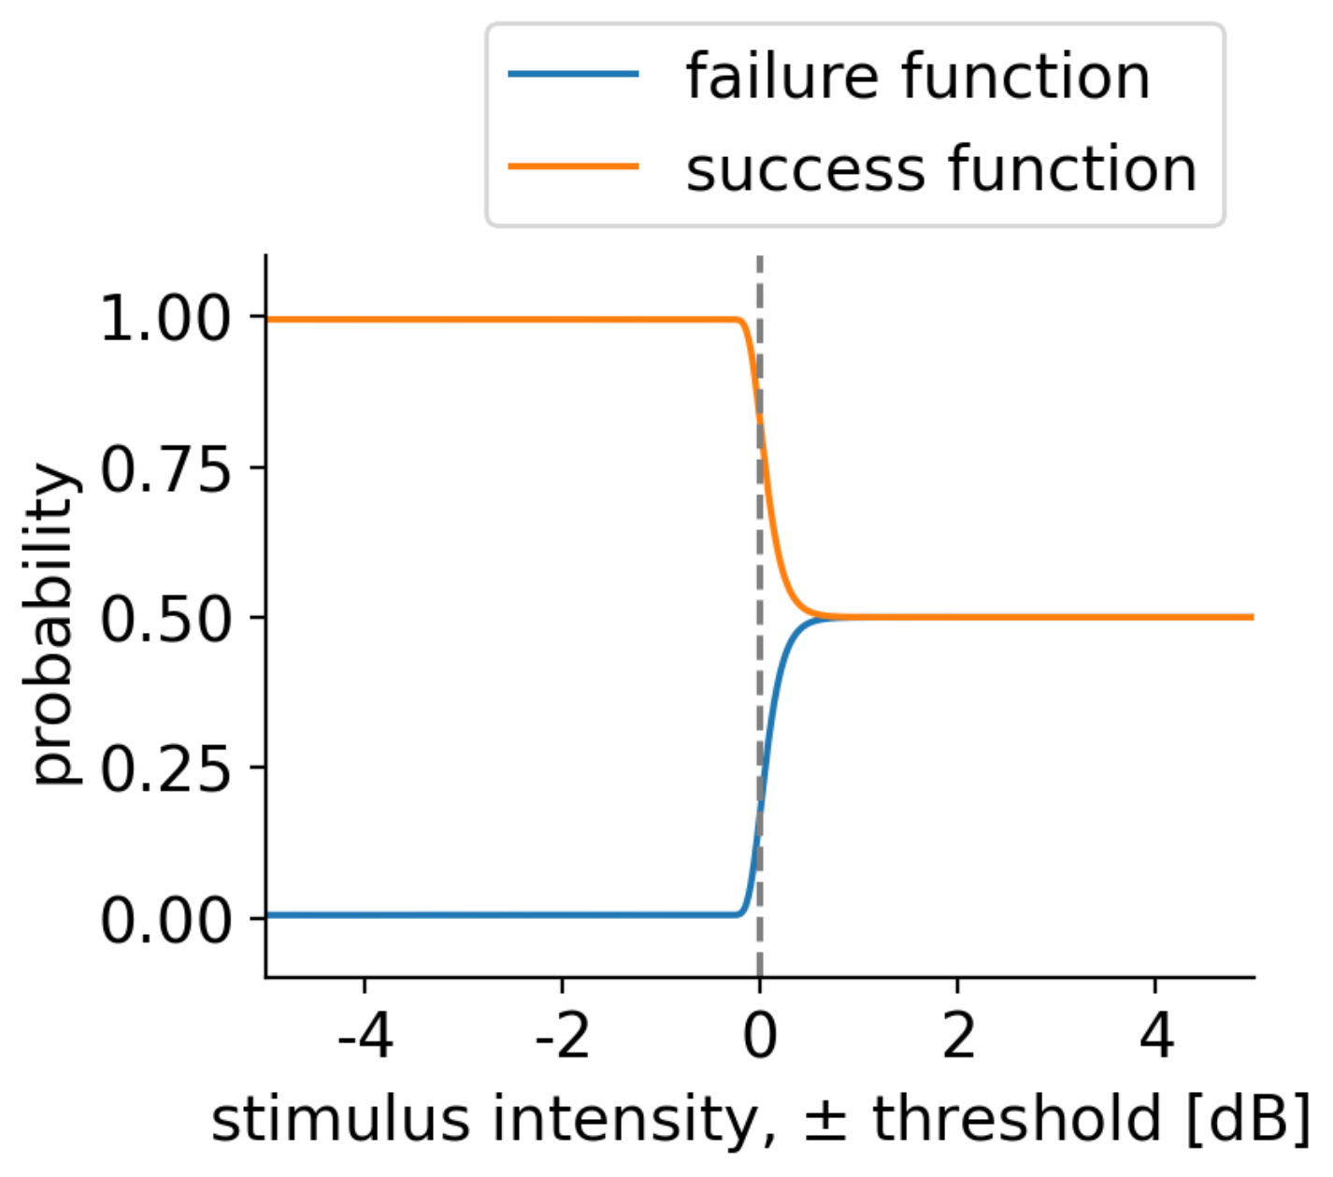
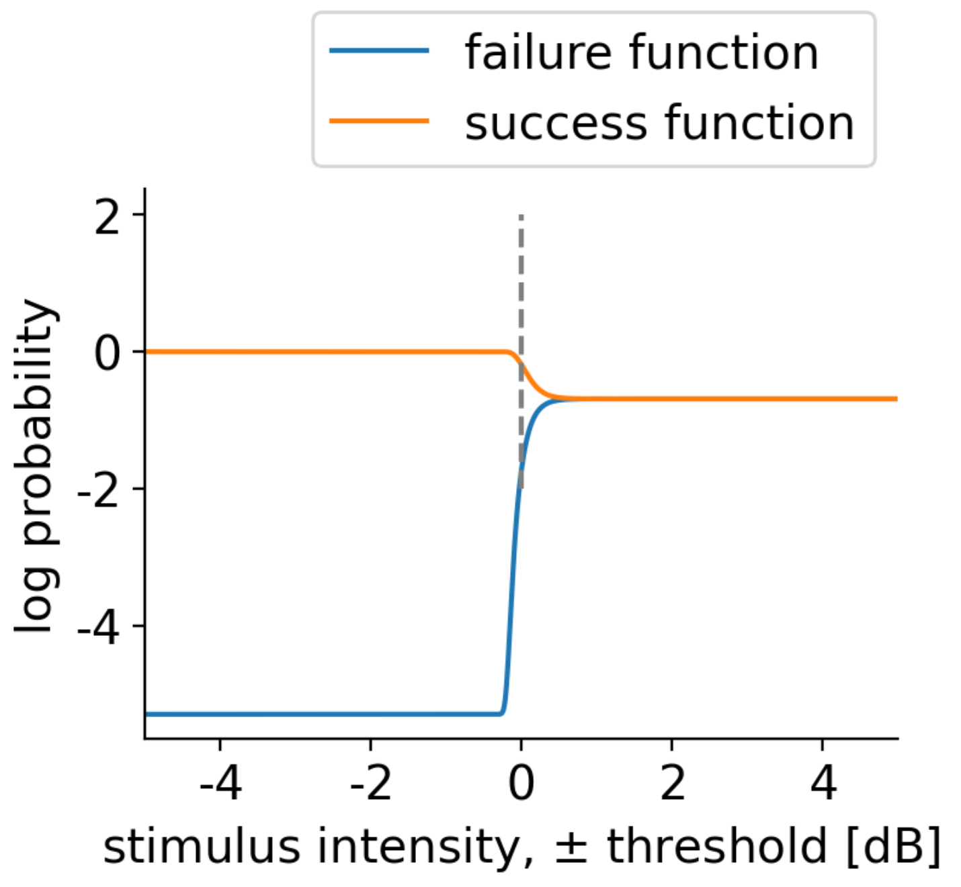

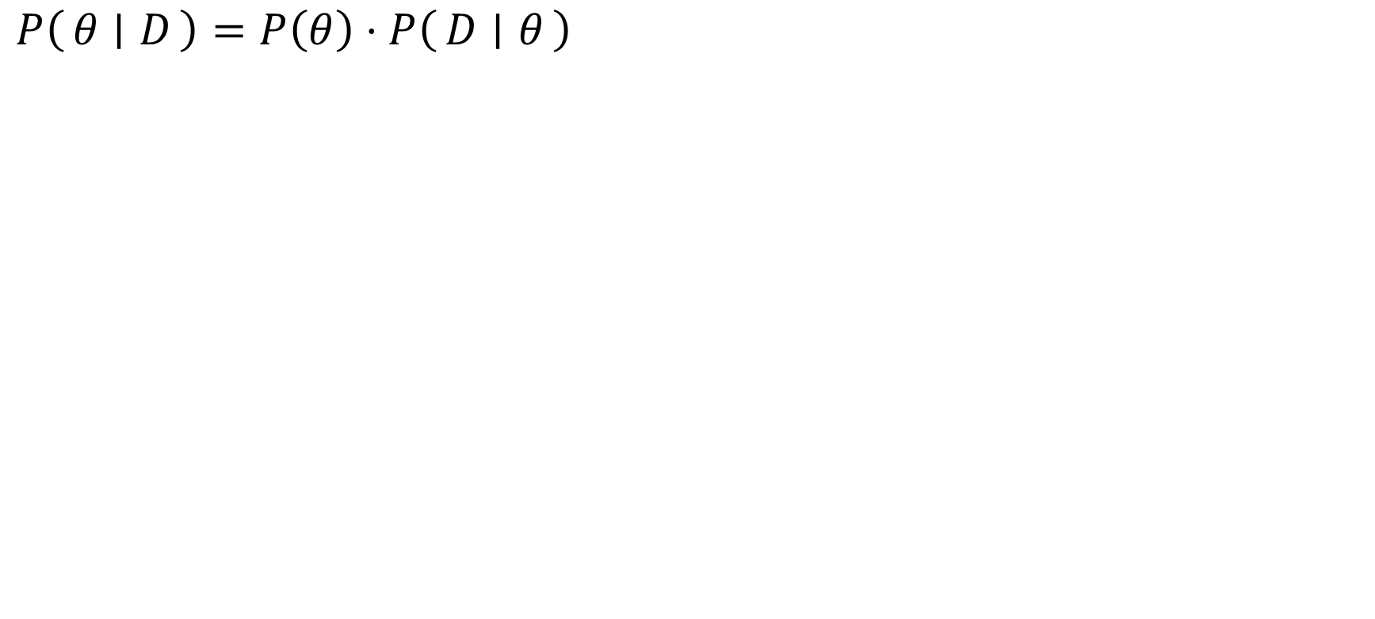
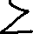
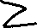
Procedure to infer $θ$
$$P\left(θ ∣ D\right)=P\left(θ\right)⋅P\left(D ∣ θ\right)$$

Slide 18
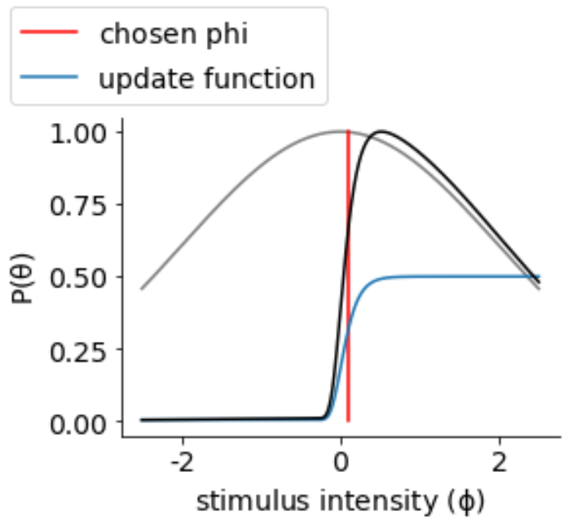
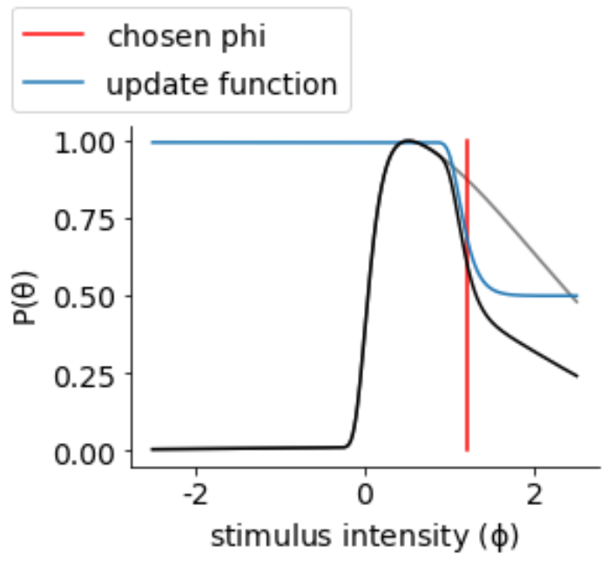




Procedure to select
Section is based on current estimation of $θ$, threshold
Several method:
mean
mode (peak)
quantile
Usually add some noise

Slide 19







Slide 20

Our model
Assume:
trained agents = $ψ$ (theta, phi)
trained network F(resp,phi)->p(theta|resp,phi) = success/failure functions
Procedure to infer $θ$ is exactly the same.
explain:
when agent did wrong, we know the stimulus phi is likely to be lower than threshold theta.
When agent did correct, we know that the stimulus phi is likely to be higher than threshold.

Slide 21
Our model phi selection
Idea, by max information or max variance.
This is exactly same as the mean method!
Logic:
the best phi will be something that gives a 75% correct, since 50-50 we just know task is too hard, and 100 we just know task is too easy.
when phi=theta, we have this 75% correct response, which maximize the information or variance or entropy.
we use current estimation of theta to reweight the information calculation.
cont on next slide

Slide 22



Our model phi selection
we use current estimation of theta to reweight the information calculation.

Slide 23


Comparison, initialization

Slide 24



Comparison, update t1

Slide 25



Comparison, update t2

Slide 26



Comparison, update t4

Slide 27

Comparison, update t1

Slide 28

Comparison, update t1

Slide 29

Comparison, update t1

Slide 30

Comparison, update t1

Slide 31

Comparison, update t1

Slide 32


Slide 33

Converge to ground truth theta=1

Slide 34
0430 cont
Our method needs about 20 steps where quest only needs 10.
Why is that?
Quest mean can be think of as a delta function conv with theta prior.
Our method can be think of as a kernel cov with theta prior.
Our kernel is not sharp enough.
Test H= Hs+Hf = -plogp –(1-p)log(1-p)

Slide 35
0505
Main goal: new information calculation leads to a new optimization criterion that achieves near identical performance as QUEST.
Side goal: new optimization by convolution, much faster

Slide 36


Near identical performance as QUEST

Slide 37
Information calculation for binary choice tasks
Option1: need to normalize p within (0,1) range?
The 2fac task produces a binomial distribution
variance is n*p(1-p), where p is the psychometric function
fisher info is inverse variance.
Option2: works!
if infinite samples, we have a like poisson distribution
fisher info is (p’)^2/p
Option3: works! But is this information?
maximize (p’)^2 / (p(1-p)).
Many people refer to this as ‘ideal sweat factor’, why is that?

Slide 38
Updated algorithm
Calculate the psy_delta function: it is the psychometric function of the difference (stimulus phi – threshold theta)
Calculate the information_delta kernel. It measures the amount of information we can get for any given theta_i, from the response of trial with stimulus phi = theta_i +delta.
Loop till converge
Convolve the current theta prior with the kernel.
Take the peak as the best task phi.
Show subject the stimulus. observe the response, then update the theta prior
Note: convolution reduce the calculation from O(nxn) to O(n) in this case

Slide 40
Lab meeting 05.24.2023

Slide 41
Outline
How Inverse Rational Control (IRC) works
Limitations on certain applications
Goal:
Can we infer latent params faster?
Can we make the whole process more efficient?
Proposed method
Brainstorm, potential task to test this?

Slide 42
Inverse rational control (IRC)
Calculate the likelihood p(subject behavior | parameter estimation)
Maximize the likelihood
Require sampling to calculate the likelihood for each iteration
Cannot/hard to reuse the samples
Good at using a lot of data to achieve a good estimation, but not using few data to achieve a rough estimation.

Slide 43


Inverse rational control (IRC)
POMDP
likelihood p(subject behavior | parameter estimation)
Marginalize over obs/action by sampling
Maximize the likelihood

Slide 44
Limitations on certain applications
Require sampling to calculate the likelihood for each iteration
Cannot/hard to reuse the samples
Good at using a lot of data to achieve a good estimation, but not using few data to achieve a rough estimation.
Potential case when these limitation matters:
quick calibration
transfer the inverse to another subject

Slide 45
Outline
How Inverse Rational Control (IRC) works
Limitations on certain applications
Goal:
Can we infer latent params faster?
Can we make the whole process more efficient?
Proposed method
Brainstorm, potential task to test this?

Slide 46
Goal
Faster inverse.
Use a neural network to approximate the likelihood calculation
Network inference is like inverse
More efficient task selection for more efficient inverse.
Adaptive task selection based on information theory
These goals are separable, do not block each other.

Slide 47
Outline
How Inverse Rational Control (IRC) works
Limitations on certain applications
Goal:
Can we infer latent params faster?
Can we make the whole process more efficient?
Proposed method
Brainstorm, potential task to test this?

Slide 48
Inference as inverse
Use a neural network to approximate the likelihood calculation.
Standard likelihood calculation:
estimated param → virtual trajectory samples → compare with actual trajectory and calculate the likelihood
Proposed:
Network training: param → trajectory → reconstruct the param
Network inference: actual trajectory → probability of param

Slide 49
Inference as inverse
Method
Training flow chart
res
Figure, train to
Figure, inference to infer the theta

Slide 50

Auto encoder and variational autoencoder
Compress the high dim input, to low dim representation
VAE: force the network to use a reparametrized representation.

Slide 51

Inference as inverse, architecture
Encoder: task environment and trained agent.
Latent representation: trajectory data T.
Maximize the reconstruction.

Slide 52
Inference as inverse, architecture
Encoder: task environment and trained agent.
Latent representation: trajectory data T.
Maximize the reconstruction.
Note: comparing to VAE, decoder has a LSTM layer to process uneven length T.
assume no distribution of T, but assume gaussian distribution of the output
also, can use discrete output.

Slide 53
Inference as inverse, example
Variable naming:
Task configuration, phi
Agent assumption, theta
Trajectories, T
Training:
1, collect all possible theta trajectories T by running the MDP
2, train a network to recover the theta
Eval:
3, the network can do inference as inverse, NN(T_actual, phi_actual) -> theta

Slide 54
Cartpole as an example task
4 observation
fully observable
3 action
left, right, no action
no action has no cost
Phi: pole length
Theta: pole length

Slide 55
Inference as inverse, example
Example result of AE architecture
Resolution=5
1000 trial per condition
25 conditions

Slide 56
Inference as inverse, example
Shade: inferred theta distribution
Dot: ground truth theta
Example result of lstmVAE architecture
Output a Gaussian distribution
Zoomed in:

Slide 57
Outline
How Inverse Rational Control (IRC) works
Limitations on certain applications
Goal:
Can we infer latent params faster?
Can we make the whole process more efficient?
Proposed method
Brainstorm, potential task to test this?

Slide 58
Adaptive task selection, logic
Select the task whose behavior can tell most information about latent param
Maximize information criterion such as fisher info or mutual info
Current estimation prior
Discrete heatmap network output: entropy->information
Continuous gaussian distribution output: fisher information
Solve a small optimization problem to find the best task

Slide 59
Adaptive task selection, ground truth
Select the task whose behavior can tell most information about latent param
Maximize information criterion such as fisher info or mutual info
Quest: A Bayesian adaptive psychometric method
Quest is a known optimal way to
select best task, in simple psychophysics

Slide 60
Adaptive task selection, example task
Binary choice
Each trial presents red or green light
Light intensity is phi
Subject is forced to choose if he saw a red or green light
Threshold theta is defined at a near 75% accuracy point

Slide 61
Adaptive task selection, example
Total information about theta, a phi can provide, can be approximated by
Cramer Rao bound general case:
(p’)^2 / (p(1-p))
Where p is the psychometric function.
Reweight the information about theta provided by phi,
by current estimation of theta.
(the theta prior)

Slide 62


Adaptive task selection, example
our method has near identical performance as Quest, in an example psychophysics threshold mapping task.

Slide 63
Adaptive task selection, example
our method has near identical performance as Quest, in an example psychophysics threshold mapping task.

Slide 64
Outline
How Inverse Rational Control (IRC) works
Limitations on certain applications
Goal:
Can we infer latent params faster?
Can we make the whole process more efficient?
Proposed method
Brainstorm, potential task to test this?

